Slide 1

GeoPackage with Encrypted Content A New Approach OGC Developers Workshop 8 December 2021
Secure Dimensions GmbH
Holistic Geosecurity
Andreas Matheus
Secure Dimensions GmbH

Slide 2
Developing a QGIS Plugin
Objective
Develop a QGIS plugin in Python to decrypt and display Feature data from a GeoPackage that uses the Encryption Extension for Features
Preparation
Install QGIS (3.22) from https://www.qgis.org/
Documentation
https://docs.qgis.org/3.22/en/docs/
https://www.qgistutorials.com/en/docs/3/building_a_python_plugin.html

Slide 3
Preparing QGIS
Install QGIS (3.22) from https://www.qgis.org/
=> Plugins / Settings
Select “Show also experimental plugins”
Install the following Plugins
Plugin Builder 3
Plugin Reloader
Install additional Python module
Execute as Administrator
C:\Program Files\QGIS 3.22.0\OSGeo4W
$> pip3 install PyCryptodome

Slide 4
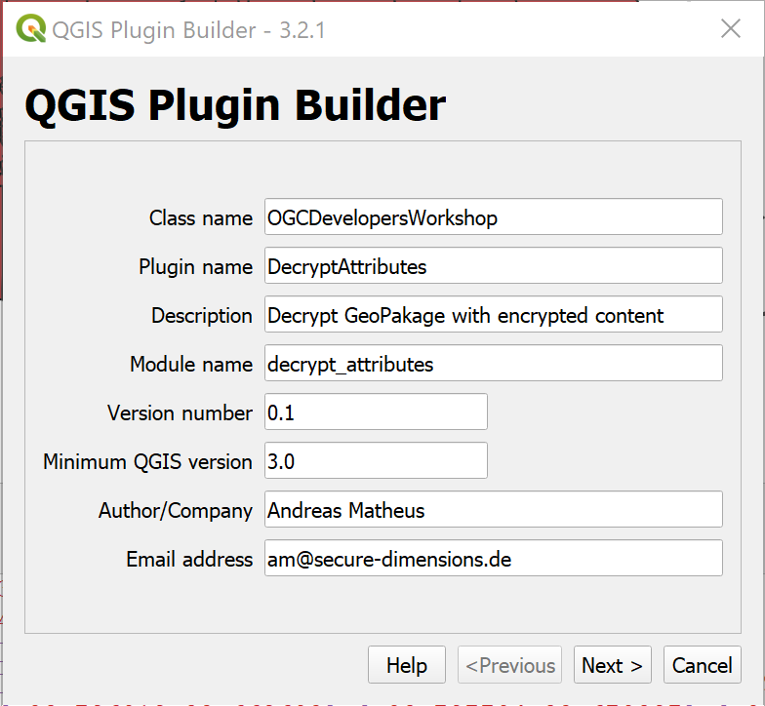
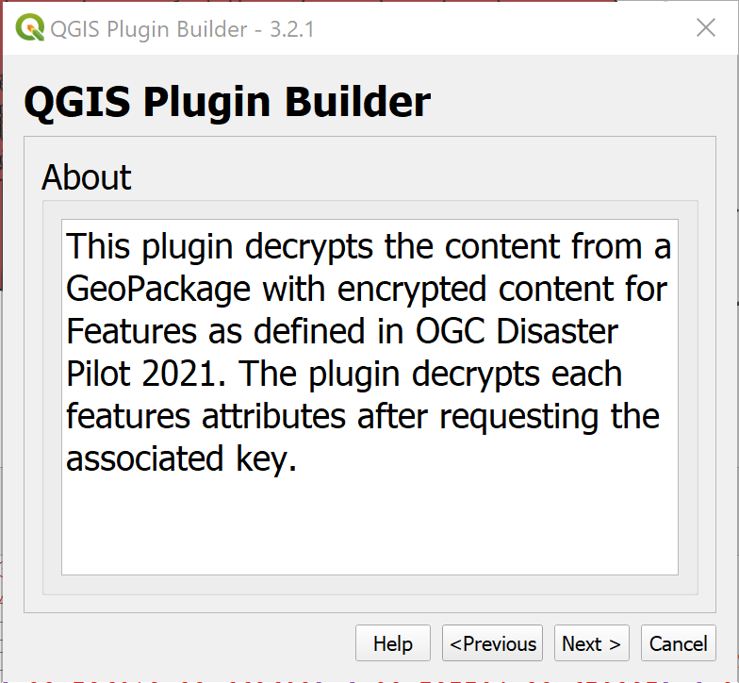
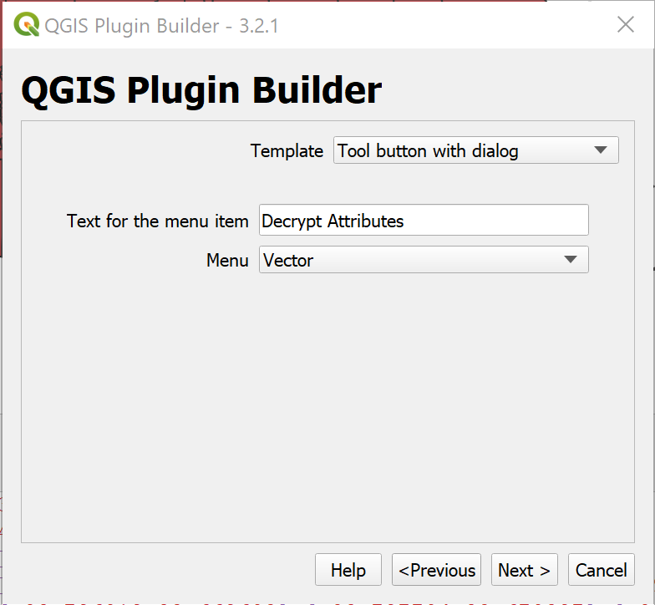
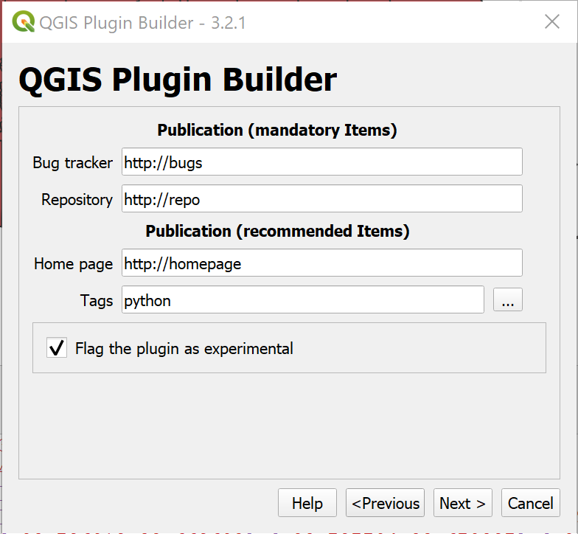
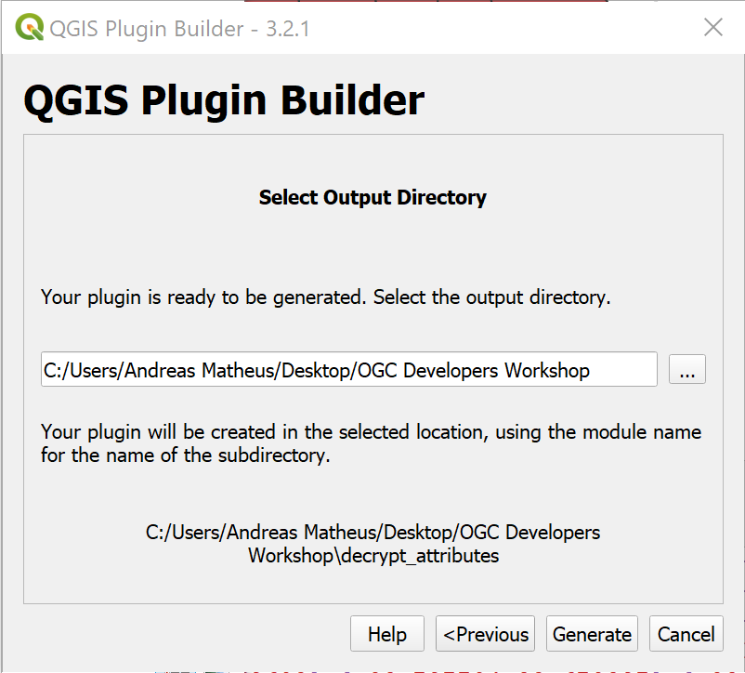
Create a new Plugin via Plugin Builder
Plugins / Plugin Builder / Plugin Builder
Store in QGIS plugins folder
Notes:
This plugin decrypts the content from a GeoPackage with encrypted content for Features as defined in OGC Disaster Pilot 2021. The plugin decrypts each features attributes after requesting the associated key.

Slide 5
Plugin Builder Result
If resources.py is not present in your plugin directory, compile the resources file using pyrcc5 (simply use pb_tool or make if you have automake)
Optionally, test the generated sources using make test (or run tests from your IDE)
Copy the entire directory containing your new plugin to the QGIS plugin directory (see Notes below)
Test the plugin by enabling it in the QGIS plugin manager
Customize it by editing the implementation file decrypt_attributes.py
Create your own custom icon, replacing the default icon.png
Modify your user interface by opening decrypt_attributes_dialog_base.ui in Qt Designer
©2011-2019 GeoApt LLC - geoapt.com

Slide 6
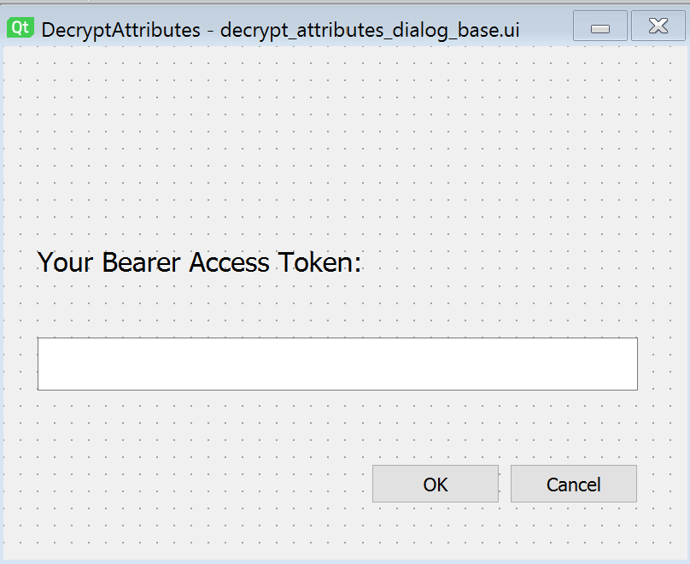
Customize the Dialog Box
Open decrypt_attributes_dialog_base.ui with Qt Designer
You can use
C:\Program Files\QGIS 3.22.0\bin\qt-designer
Insert a QTextEdit and name it accessTokenInput
Insert a QLabel and add text
Your Bearer Access Token:
Save the file

Slide 7
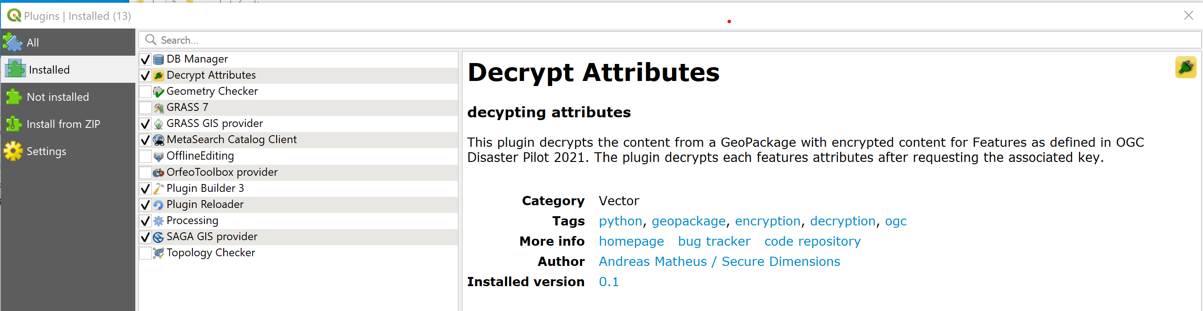
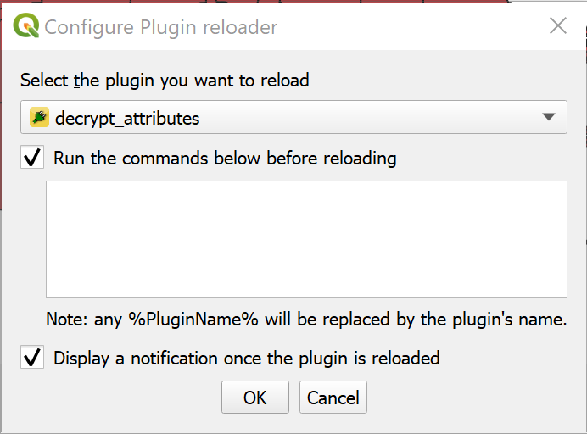
Install the Plugin
Copy files to QGIS plugins folder & re-open QGIS
Plugins / Manage and Install Plugins…
Configure Reload Plugin
Select decrypt_attributes

Slide 8

Customize the Plugin Code
Open decrypt_attributes.py in Notepad++
Go to function def run(self):
Replace code pass with the first code version
Reload the Plugin
Execute Plugin
if result:
print (self.dlg.accessTokenInput.toPlainText())

Slide 9
Observe Plugin @ Work
Input some text into the text box
Observe the Python Console to echo your input

Slide 10
Extending Plugin Functionality (1/2)
Get all selected features and iterate
layer = self.iface.activeLayer() features = layer.getSelectedFeatures() for feature in features: print(str(feature['id']))
Get decryption key from KMS
import requests
kid = feature['kid'] # Obtain the access token from the dialog box provided to the user token = self.dlg.accessTokenInput.toPlainText(); # Construct the KMS URL to fetch the key url = "https://ogc.secure-dimensions.com/kms/dek/" + kid # Fetch the JWK encoding of the key response = requests.get(url, headers={'Authorization': 'Bearer {}'.format(token)}) print(response.content.decode('utf-8'))

Slide 11

Happy Coding ☺
Let’s get it done…

Slide 12
Extending Plugin Functionality (2/2)
# Import the Crypto library from Crypto.Cipher import AES from Crypto.Util.Padding import unpad # import Base64 library from base64 import urlsafe_b64decode
# The JWK of the decryption key keyData = response.json() # The data to decrypt data = feature['data'] # The k value contains the JWK equivalent BASE64 encoded # Needs padding == at the end before base64 decoded k = urlsafe_b64decode(keyData['k'] + "==") # The IV is the first 16 bytes iv = bytes(data[:16]) # Create an AES cipher TODO: make more flexible cipher = AES.new(k, AES.MODE_CBC, iv) # Decrypt the data starting at byte 16 attributes = unpad(cipher.decrypt(bytes(data[16:])), AES.block_size) # Print the decrypted GeoJSON of the Feature to Python console print (attributes.decode('utf-8'))

Slide 13
Solution Plugin Decrypt Attributes
Extract decrypt_attributes.zip file into directory plugins
Settings / User Profiles / Open Active Profile Folder
$> cd python\plugins
$> unzip decrypt_attributes.zip
Re-open QGIS
=> Plugins / Manage and Install Plugins…

Slide 14
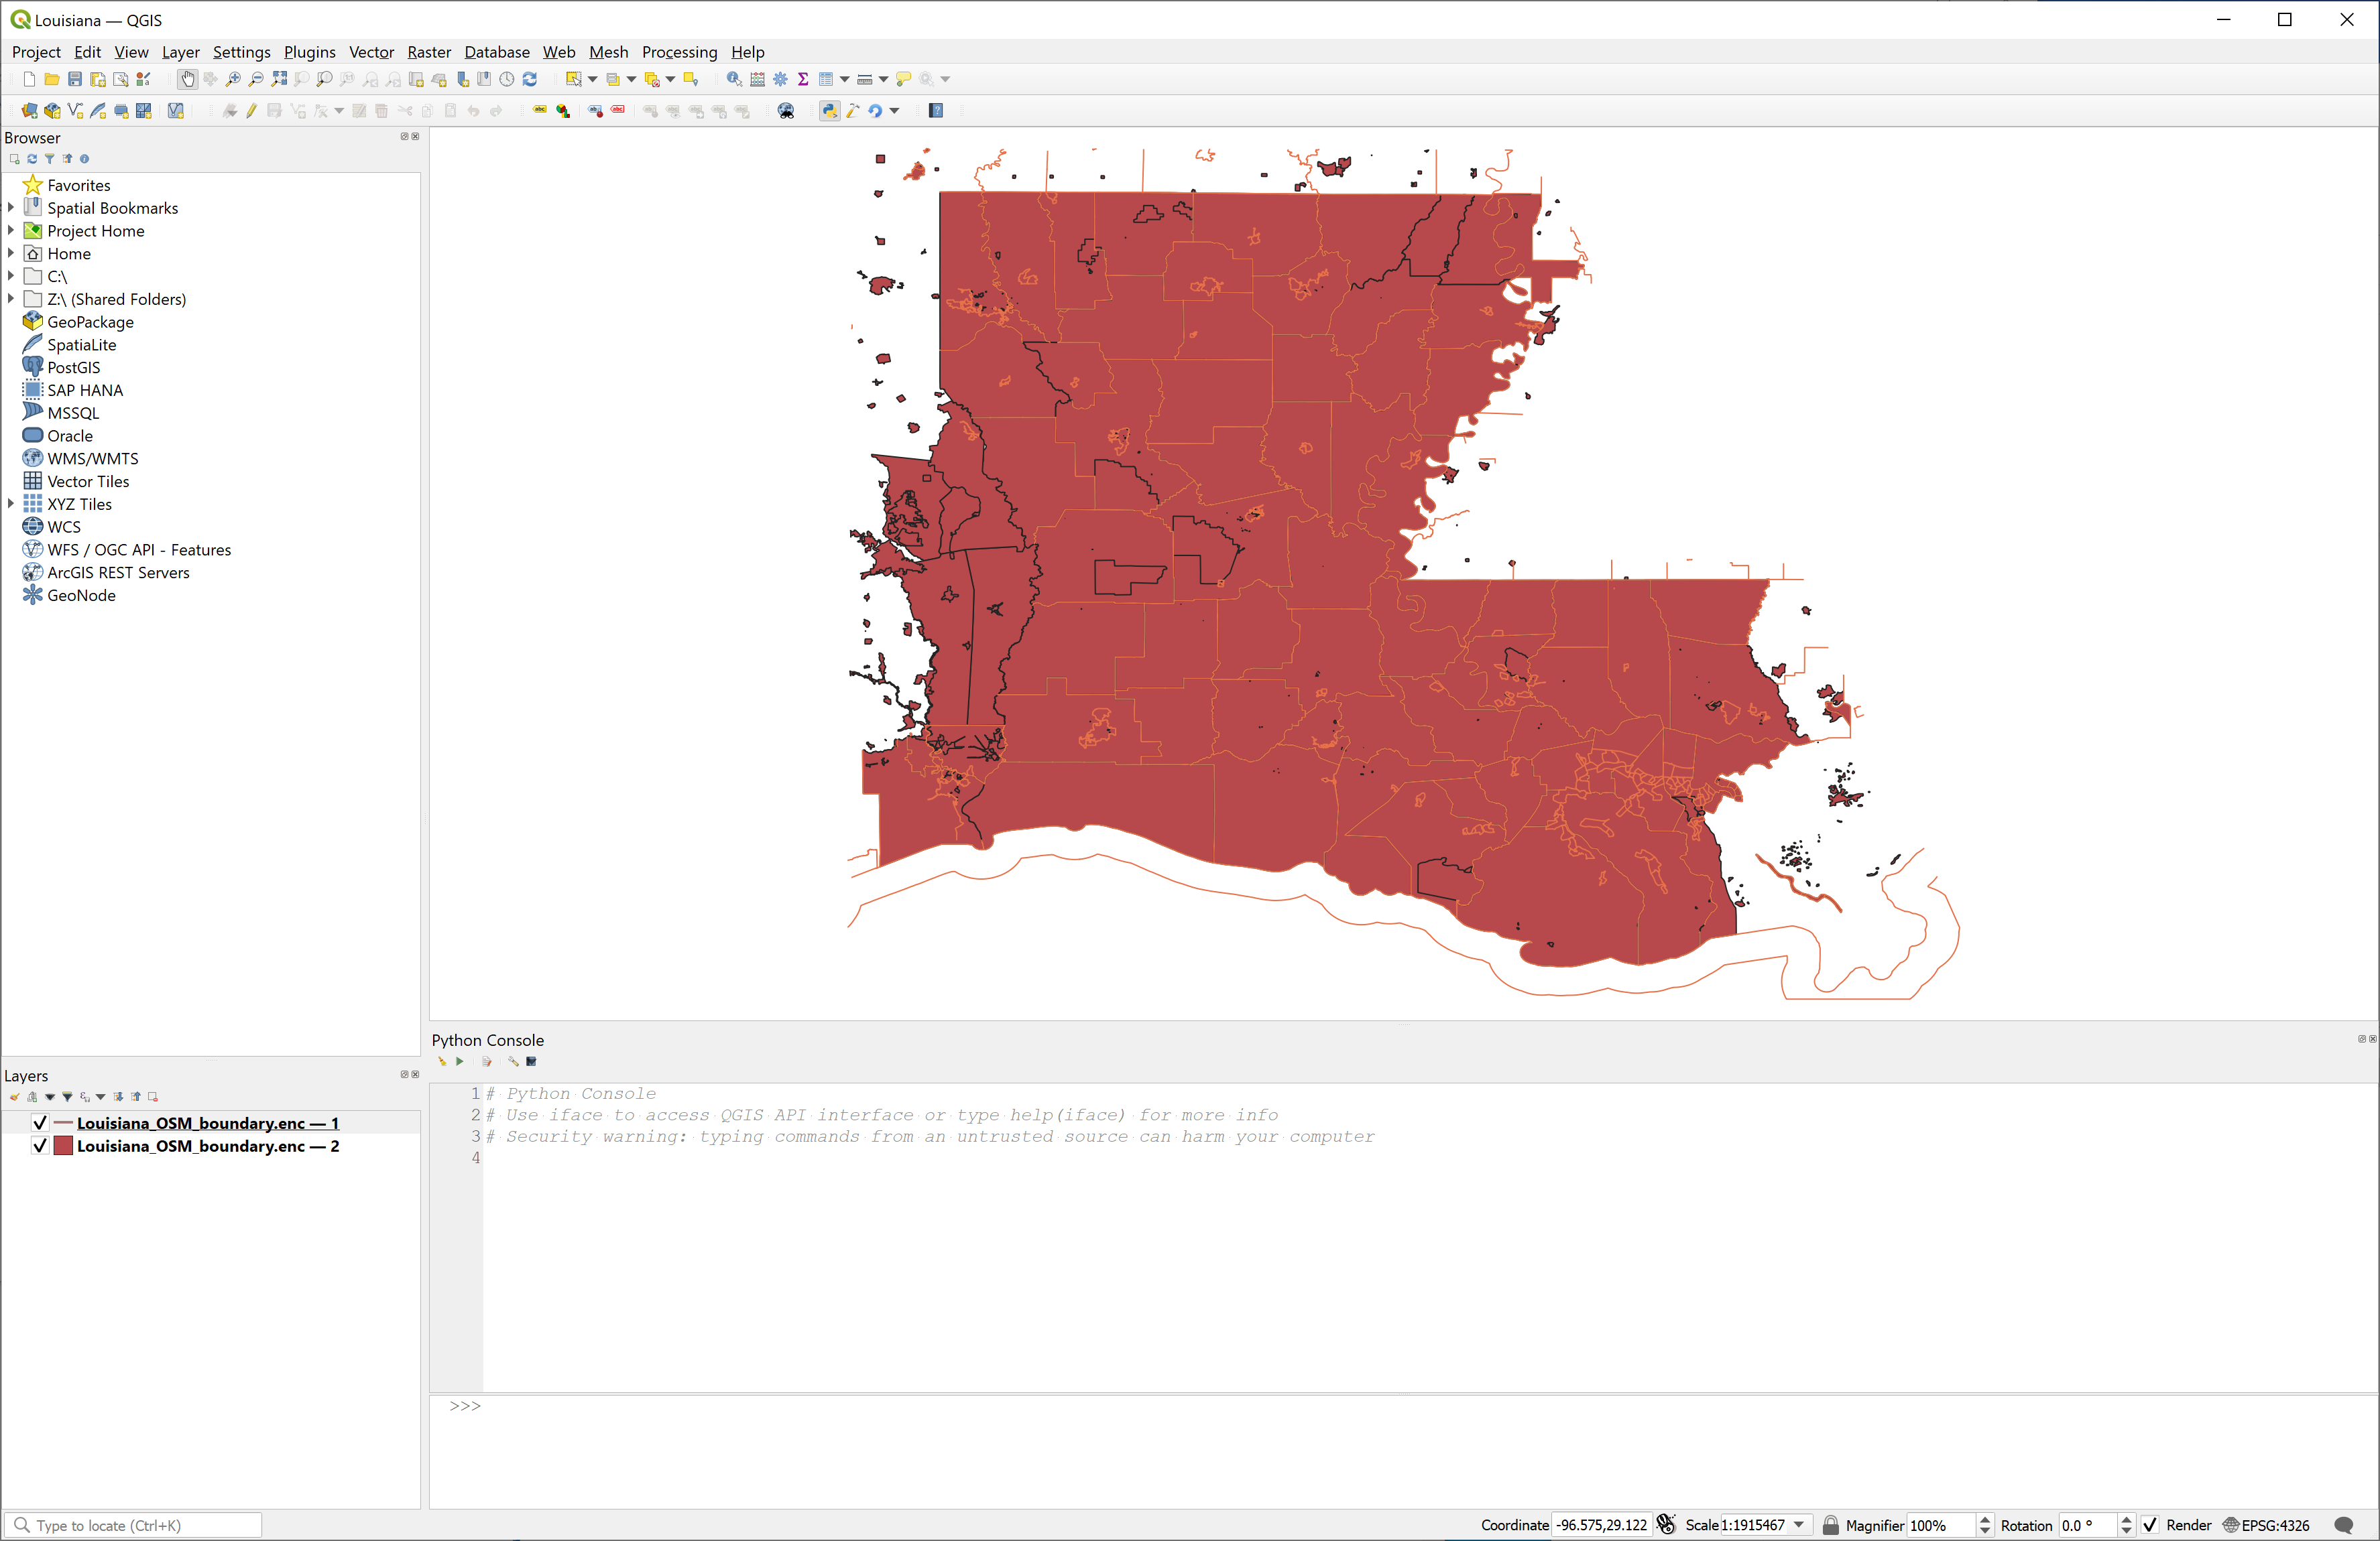
Load GeoPackage with QGIS

Slide 15
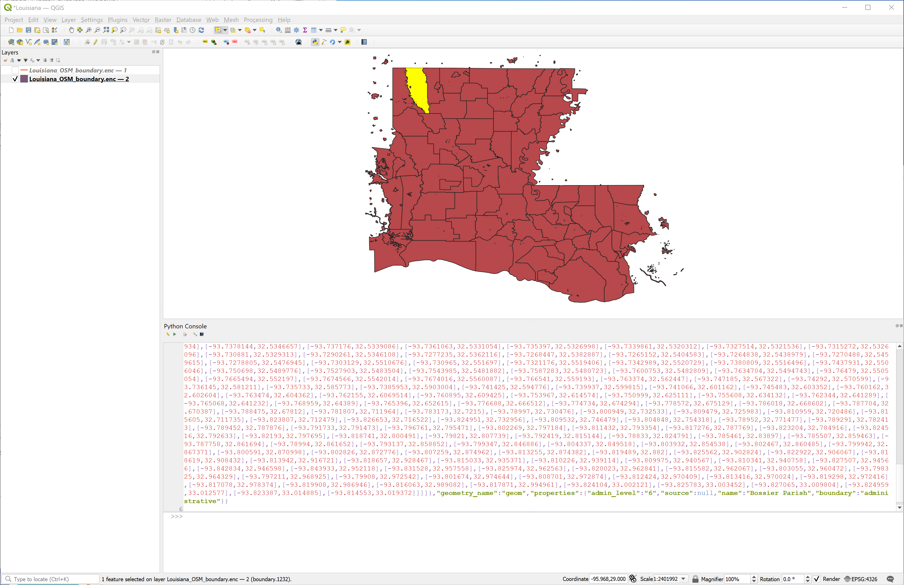
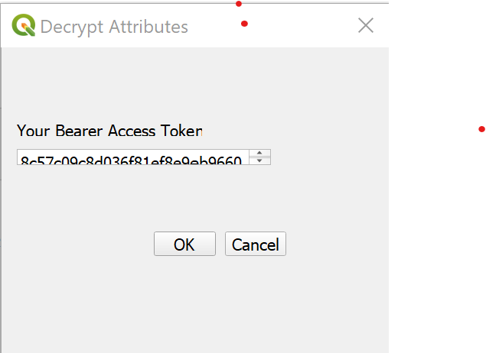
Run the Plugin Decrypt Attributes
make sure you have a layer selected
select one or more features

Slide 16

Thank You!
It is important, to do security right...
Secure Dimensions GmbH
Holistic Geosecurity
Dr. Andreas Matheus
Waxensteinstr. 28
D-81377 München, Germany
Phone +49 (0)89 38151813-0
Mobile +49 (0)160 1066366
Telefax +49 (0)89 38151813-9
Email am@secure-dimensions.com
Web www.secure-dimensions.com

